Slide 1
LEADERSHIP
BY: RABIA IJAZ
Fast-nuces , Karachi

Slide 2
LEARNING outcomes
Recipe for being a Leader
Understanding Leadership styles

Slide 3
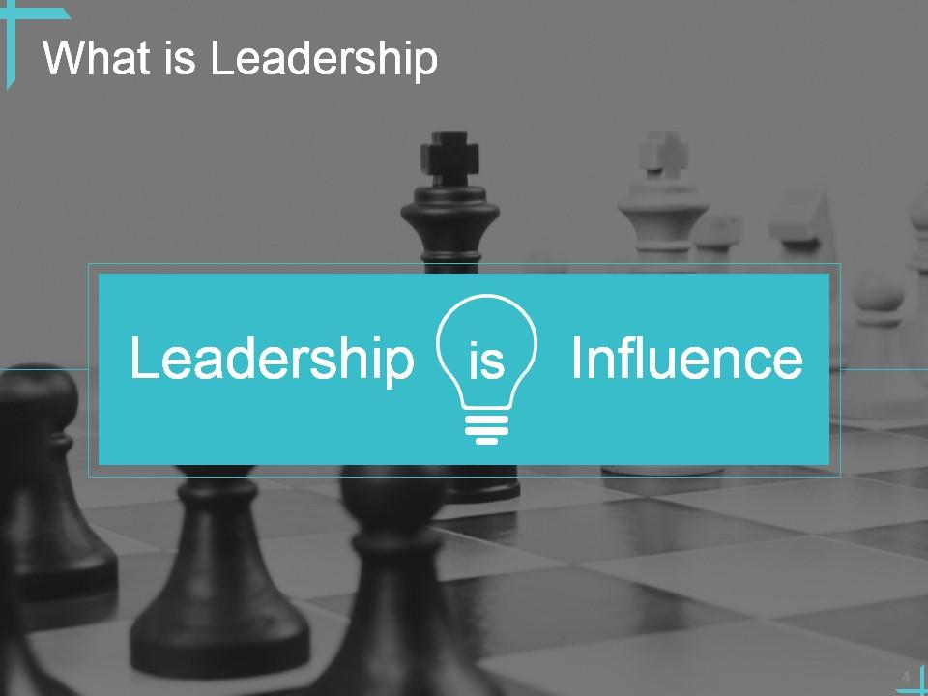
Notes:
leadership is influence, mean that being a leader is all about having the power to persuade and inspire others to work together towards a common goal. It's like being the captain of a team where everyone listens to your ideas because they trust and respect you, not just because you're in charge.

Slide 4
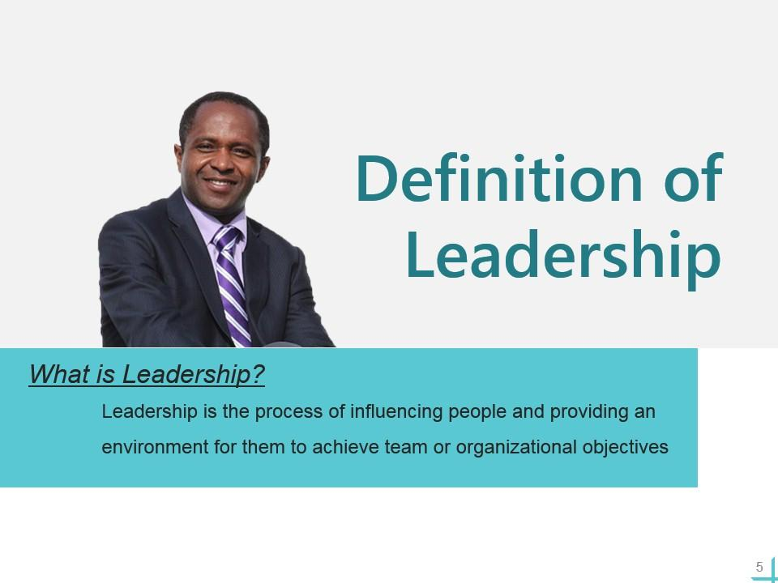

Slide 5
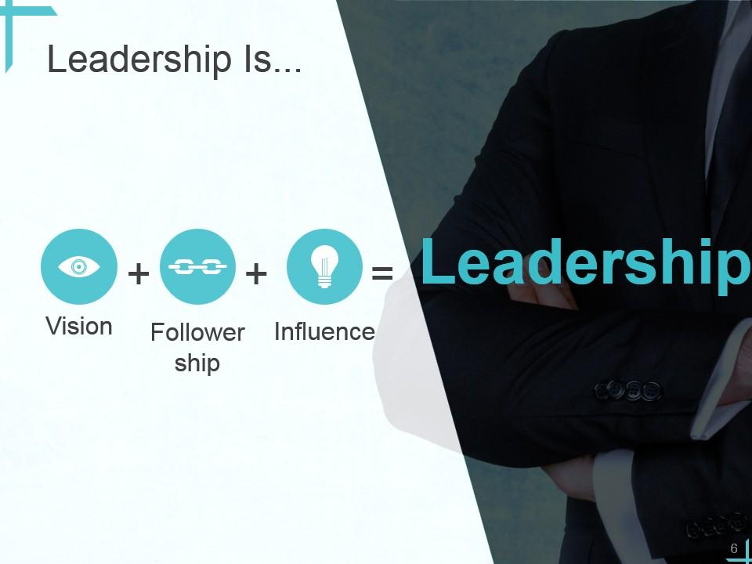

Slide 6
Leadership encompasses several key elements, including vision, followership, and influence. Let's simplify each concept:
Vision: This is like having a roadmap or a clear picture of where you want to go. A leader with vision knows what they want to achieve and can communicate that vision to others in a way that inspires and motivates them. It's like being able to see the destination and guiding others towards it.
Followership: While leadership often gets the spotlight, followership is equally important. Followership is about trusting and supporting the leader's vision and direction. Just like in a dance where one person leads and the other follows, effective leadership relies on having people who are willing to follow and contribute to the vision.
Influence: This is the magic ingredient that ties everything together. Influence is the ability to persuade, inspire, and motivate others to take action. It's about getting people on board with the vision and guiding them towards achieving it. Think of influence as the fuel that powers leadership.

Slide 7
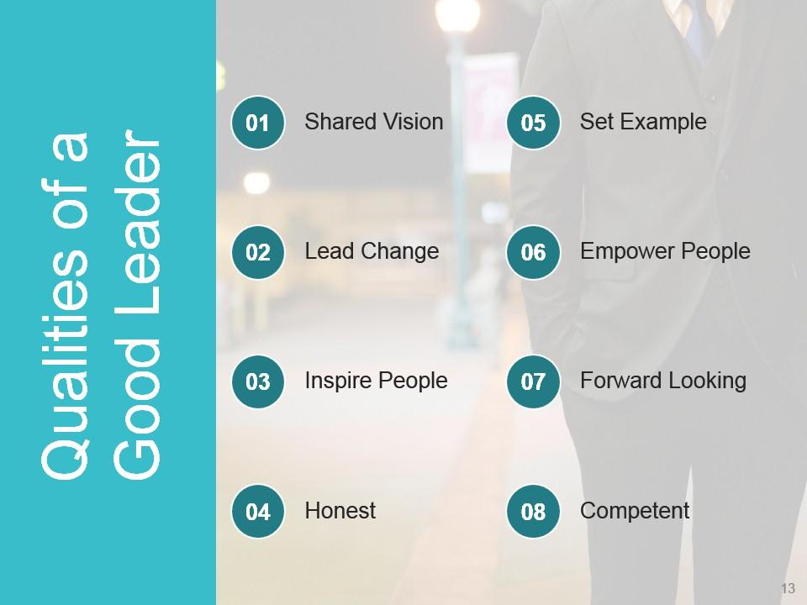

Slide 8
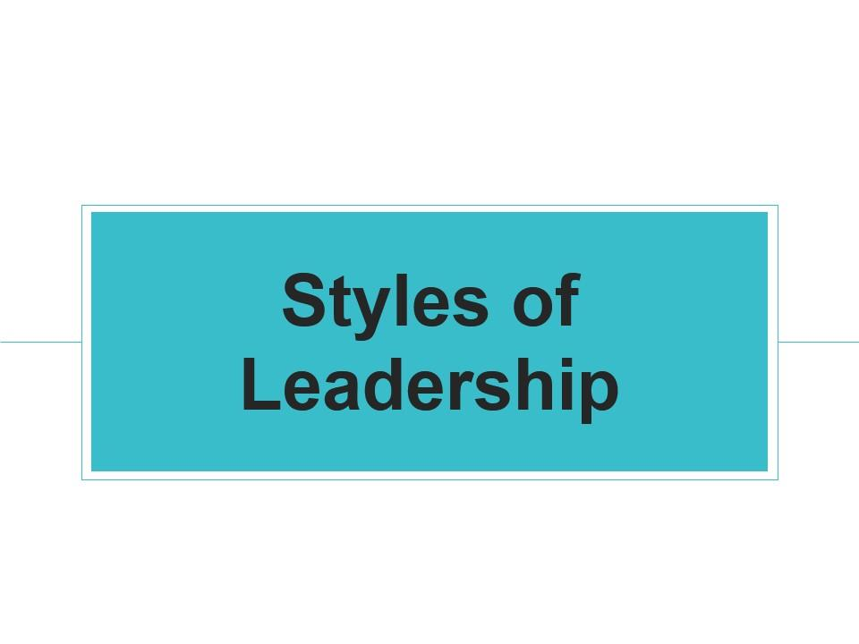

Slide 9
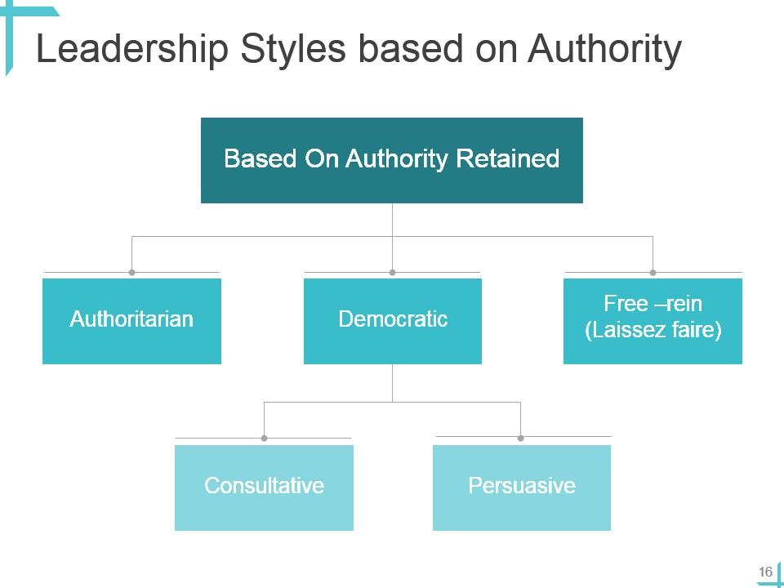

Slide 10
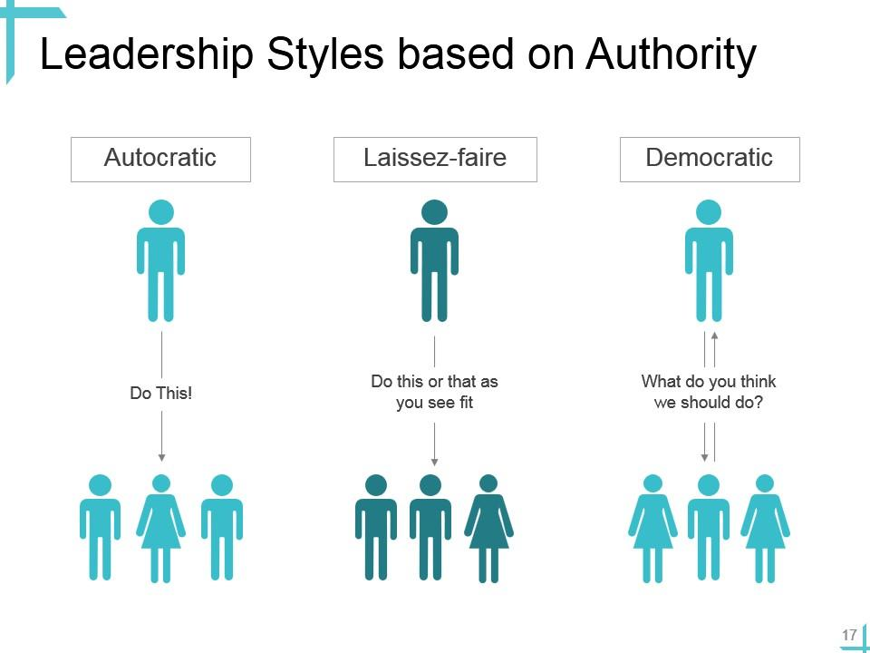

Slide 11
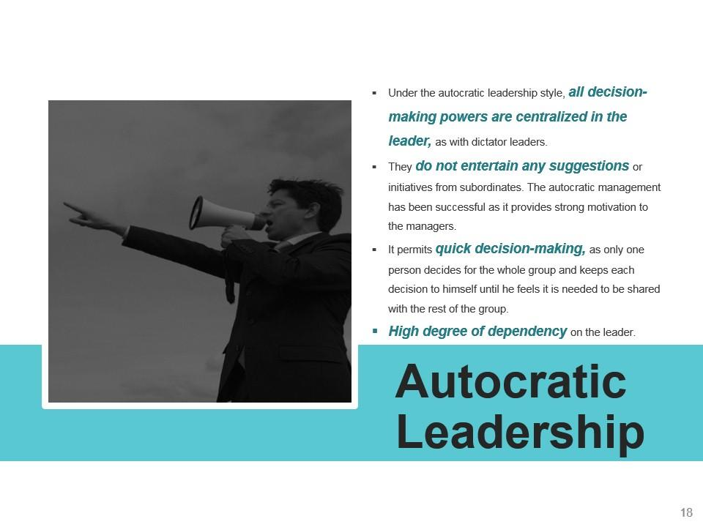

Slide 12

Autocratic:
Leader makes decisions without much input from others.
They have full control over the team and often give orders rather than engage in discussions.
While this style can be efficient in certain situations, it can also impacts creativity and morale.

Slide 13
PROS
CONS
Ensures faster decision making.
Enhances workplace communication.
Improves productivity.
Improves crisis management.
Reduced employee stress
Direct Communication
Limited Innovation/Lacks creativity.
Creates a lack of trust.
Creates a high-pressure working environment.
Dependency
Risk of Errors

Slide 14
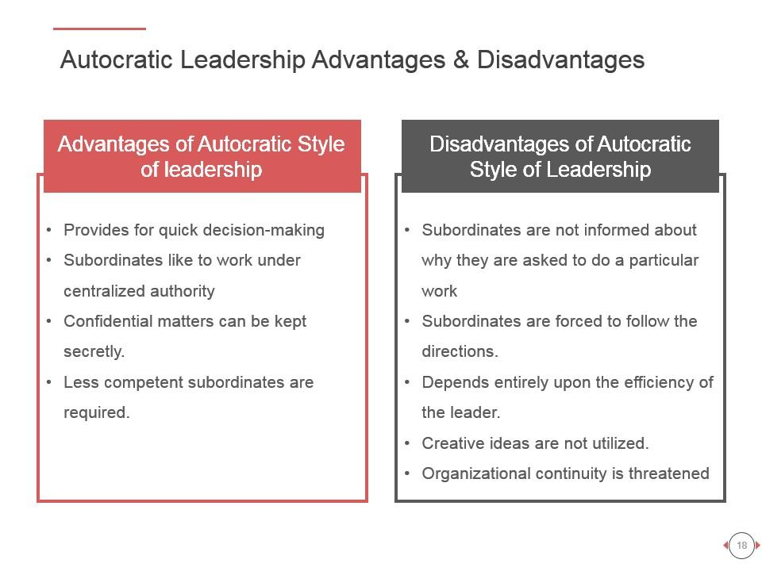

Slide 15
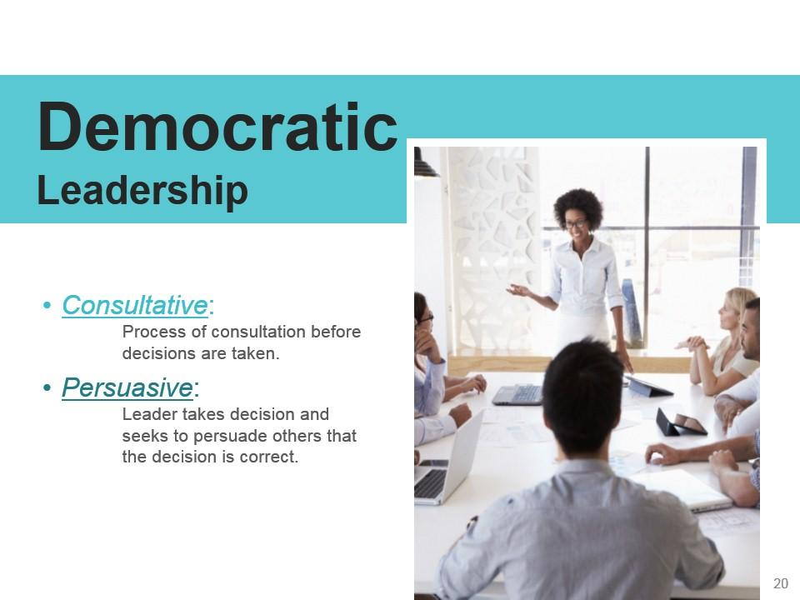
Democratic:
Democratic leaders involve their team members in decision-making processes.
They value input from others, encourage participation, and foster a sense of ownership among team members.
This style can lead to higher morale and innovation but may be slower in decision-making compared to autocratic leadership.

Slide 17
PROS
CONS
Increased Participation
Diverse Perspectives
Enhanced Morale
Adaptability/flexibility
Time-Consuming
Conflict and Disagreement
Risk of Decision Paralysis
Lack of Accountability

Slide 18
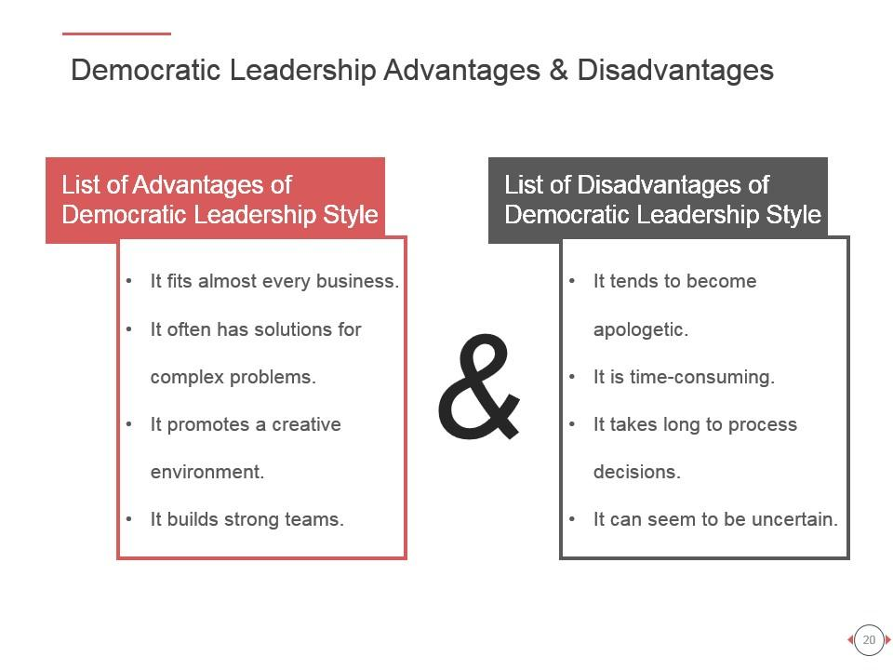

Slide 19
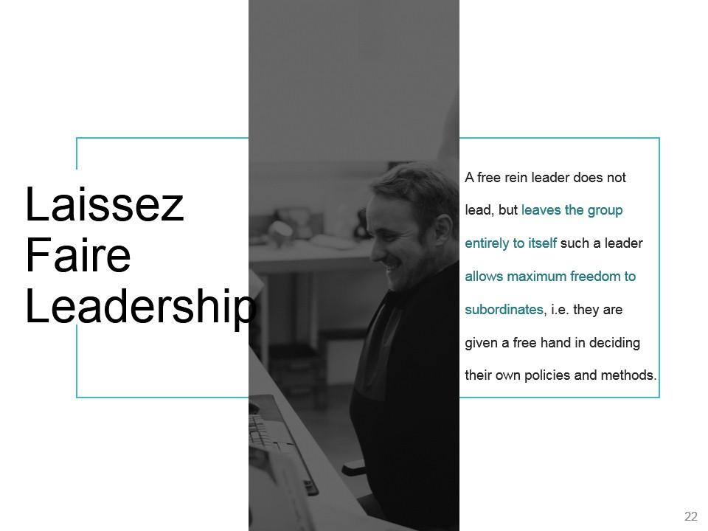

Slide 20
‘Let it be’ – the leadership responsibilities are shared by all
Can be very useful in businesses where creative ideas are important
Can be highly motivational, as people have control over their working life
Can make coordination and decision making time-consuming and lacking in overall direction
Relies on good team work
Relies on good interpersonal relations

Slide 21
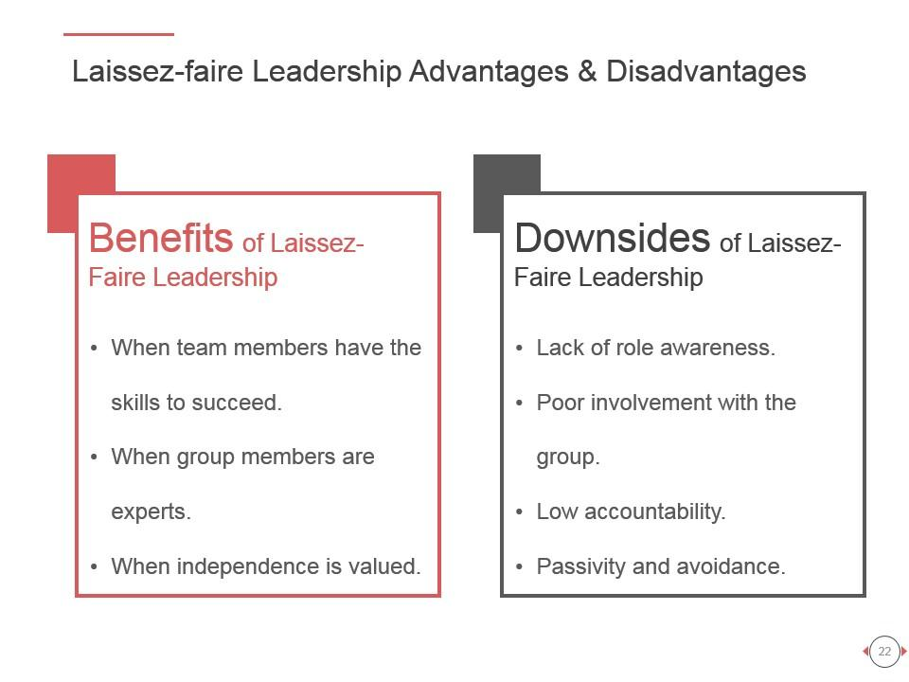

Slide 22
Recipe for being a Leader
Take control of your life
Assume responsibility for who you are
Convey a positive and dynamic attitude in everything you do
Accept blame: learn from your own mistakes as well as those of others. Take blame for everything that happens in your unit
Give credit wherever it is due
Be compassionate when you review your team members' progress or lack thereof

Slide 23


